Slide 1
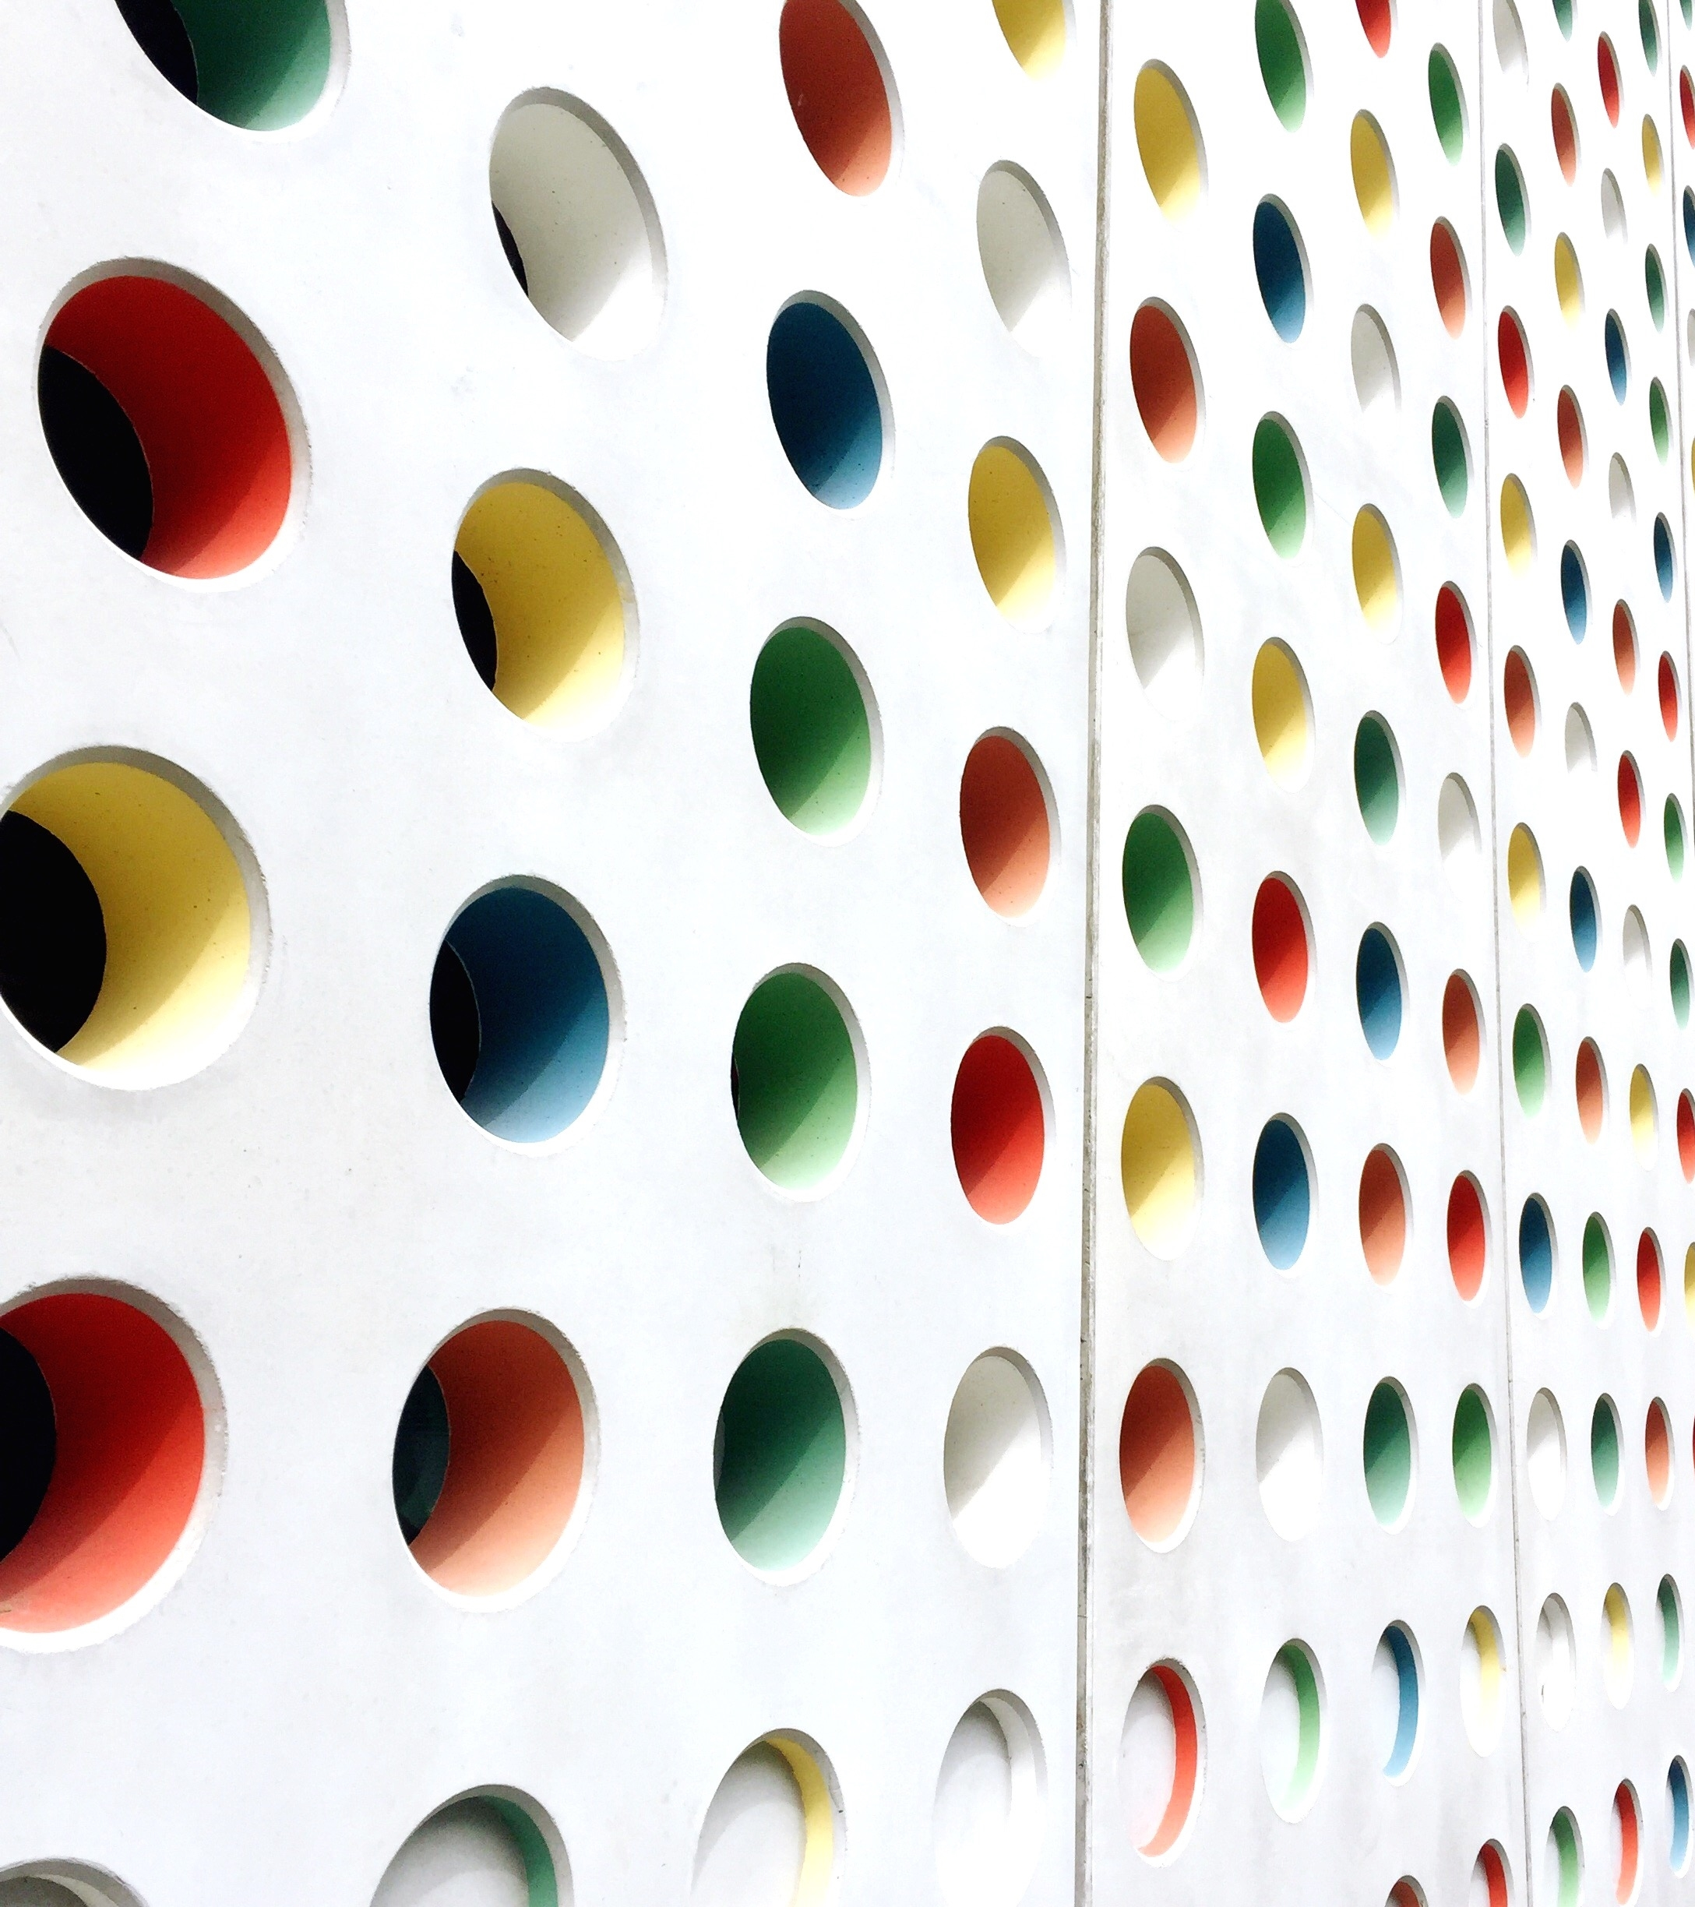
Beta Meeting
2/5/25

Slide 2
Agenda
Beta tapping
Induction ceremony
Volunteer opportunity
Math tutors
Relay 4 Life
Relay 4 Life

Slide 3
Beta Tapping
Friday, 2/14/25
During 1st Period
We need 10 volunteers
Check with your 1st period teacher to see if you can miss about the first 20 minutes of class.
First 10 to email loweryd@leonschools.net will be the “chosen ones”-earn 1 hour

Slide 4
Induction Ceremony
Induction: March 26, 6:00pm
Rehearsal: March 25, 8:15am
Mandatory for board members-5 service hours
Need at least 10 other members-5 service hours
Check with your parents first
If you are able to attend, send a message via remind letting us know you are in

Slide 5
Volunteer Opportunity
Thursday, 2/27/25
Roberts Elementary
If you are able to help out, contact
conradl@leonschools.net

Slide 6
Volunteer Opportunity
Montford Curriculum Fair
Tuesday, 2/25/25, meet new 6th graders
We need 2 Beta members- 3 hours
Check with parents
Email sullivana@leonschools.net

Slide 7
Math Tutoring
Wednesdays 8:45-9:20
Mrs. Lowery’s classroom
7th Graders we need you to step up!
Email loweryd@leonschools.net if you are interested in helping others build math skills

Slide 8
Relay 4 Life
Top 3 coffee sellers pick a prize
Thank you to all!! We couldn’t have done it without the entire beta club. Teamwork and all. ☺

Slide 9
Next Beta Meeting
**3/19/25

Slide 10
NEW BETA SHIRT COMING SOON!!

Slide 11
Team Building Game
Balloon Tower
Supplies: tape and balloons
How high can you make a free standing tower of balloons?

